Slide 1
CLTV Predictive Segmentation for personalized insurance policies
Course ID: CSE 572
Group: 21
Members:
Shreyas Hingmire
Nayan Bhiwapurkar
Sudeeksha Vandrangi
Vaishnavi Chunchu
Toshal Warke
Notes:
Hi everyone,
It gives us great pleasure to welcome you to our project presentation for the CSE 572 course. We chose to explore a dataset that holds the intricate details of customer interactions and policy dynamics and forecast the Customer Lifetime Value (CLTV) and engage in predictive segmentation to tailore personalized insurance policies.

Slide 2
Introduction:
Background: Vahan Bima, a leading Indian motor vehicle insurance company, seeks to enhance customer experience through personalized programs.
What: The project involves building a machine learning model to predict Customer Lifetime Value (CLTV) based on user and policy data, and segment customers into different segments
Why it matters: By using CLTV and segmenting customers, the company aims to strategically personalize services, improving customer satisfaction and loyalty.
Notes:
A little background regarding the project. Vahan Bima is a prominent motor vehicle insurance company and they wish to forecast the CLTV based on the user and policy data. They further seek to segment the customers based on the data to improve their satisfaction and loyalty through personalized programs.

Slide 3
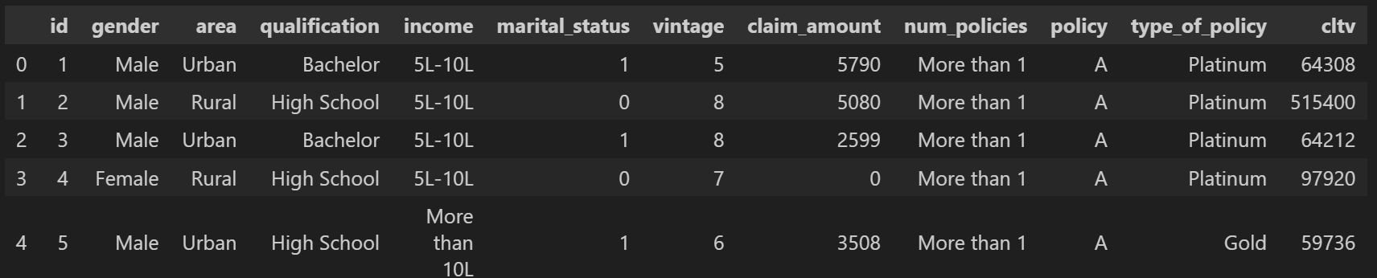
Problem Formulation
Dataset Overview: The dataset consists of detailed information about customers and their engagement with different customer policies.
Goal: To predict the CLTV metric, based on customer and policy features; Regression task
Segment the customers for enhanced personalized policies; Clustering task
Notes:
Moving forward, let's now take a look at the dataset:
The VahanBima dataset provides a comprehensive snapshot of customer and policy information, serving as a valuable resource for predictive modeling. Key features include unique customer identifiers (id), gender, area, highest qualification, annual income, marital status, vintage (years since the first policy), total claimed amount (claim_amount), the number of policies issued (num_policies), details of the active policy, type of policy, and the target variable - Customer Lifetime Value (CLTV).
This dataset is particularly well-suited for regression tasks aiming to predict CLTV, allowing the development of models that can forecast the long-term value of customers. The diverse set of features, ranging from demographic information to policy details, offers the potential to uncover complex relationships and patterns that influence customer lifetime value.
Additionally, the dataset could be used for clustering tasks to segment customers based on shared characteristics, aiding VahanBima in tailoring personalized experiences and optimizing customer engagement strategies.
However, potential challenges include handling outliers, addressing multicollinearity, and ensuring appropriate preprocessing for effective model development. Overall, the VahanBima dataset provides a rich foundation for data mining tasks aimed at enhancing customer experience and strategic decision-making within the insurance company.

Slide 4
Data Mining Pipeline
Data Collection
Data Pre-Processing
Encoding, Handling outliers
Discretization, Feature Engineering
EDA
Exploratory Data Analysis
Model Selection
Selecting ML model based on validation dataset accuracies
Train
different
ML models
on Training Dataset
Data Splitting
(Train, Test, Validation)
Calculate Accuracy
of Model
on Test Dataset
Improve Accuracy
(Hyper-parameters, K-Fold)
Clustering Customers

Slide 5
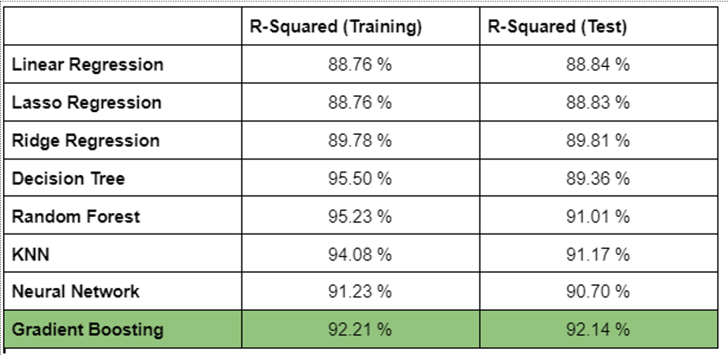
Ml model

Slide 6
Gradient Boosting - hyperparameter tuning
Tried various combinations of parameters:
N_estimators - 50, 100, 150
Learning rate = 0.05 , 0.1 , 0.2
Depth of tree = 3,4,5
Min_samples split = 10, 20, 30
K-Fold cross validation

Slide 7
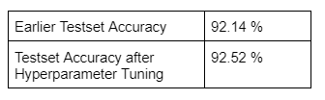
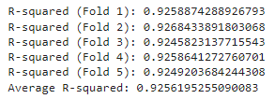
Gradient Boosting - hyperparameter tuning
Optimal parameters -
N_estimators -150 ; Learning rate = 0.2 ; Depth of tree = 5
Min_samples split = 20

Slide 8
Challenges during clustering
Choosing the right algorithm: Mini Batch K-Means and Birch
Finding the optimal value of ‘K’
Evaluation metrics used
Insufficient computational power

Slide 9
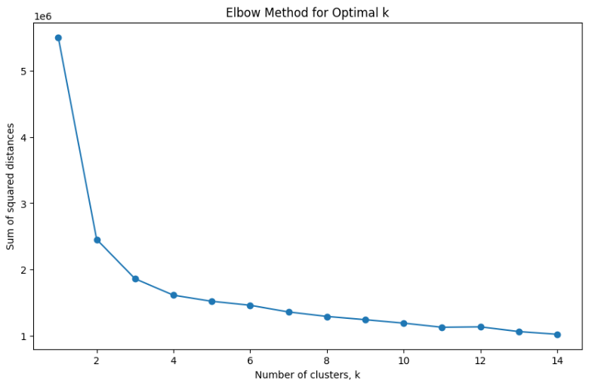
Elbow Method: Optimal K
As observed, the optimal number of clusters = 3

Slide 10
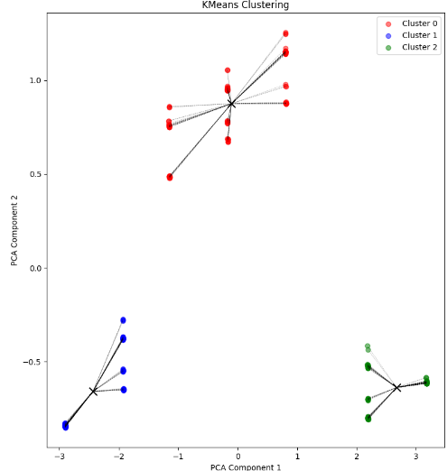
K-Means
Mean SSE per cluster | [2.13479896 1.58609141 1.59215926]
Mean SSE | 1.8236405024953715

Slide 11
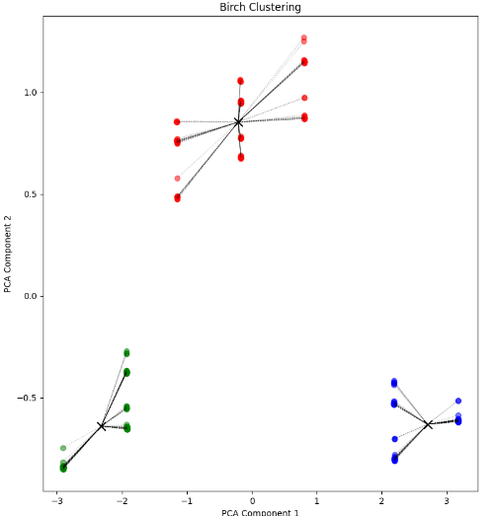
BIRCH
Mean SSE per cluster | [2.134795418479746, 1.5921562201707073, 1.5860873668108648
Mean SSE | 1.8236369599365954

Slide 12
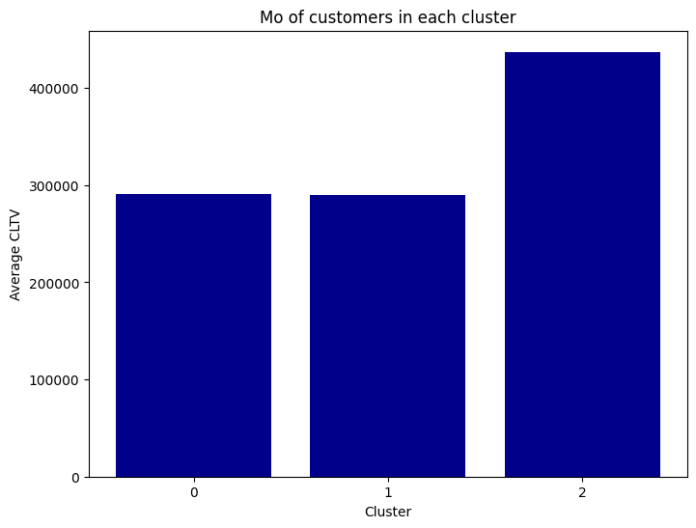
EDA

Slide 13
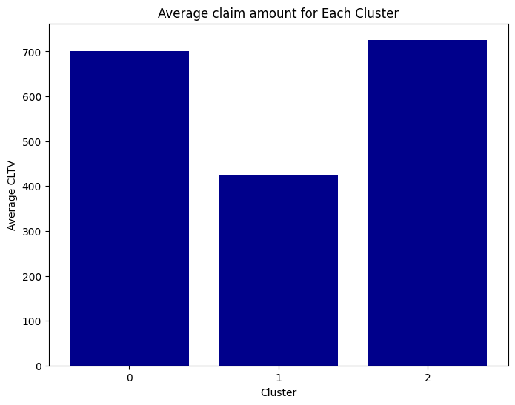
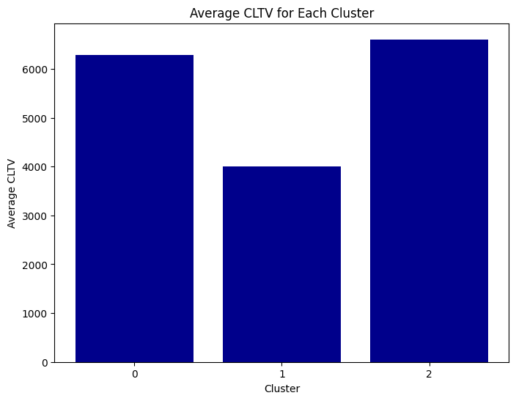
EDA

Slide 14
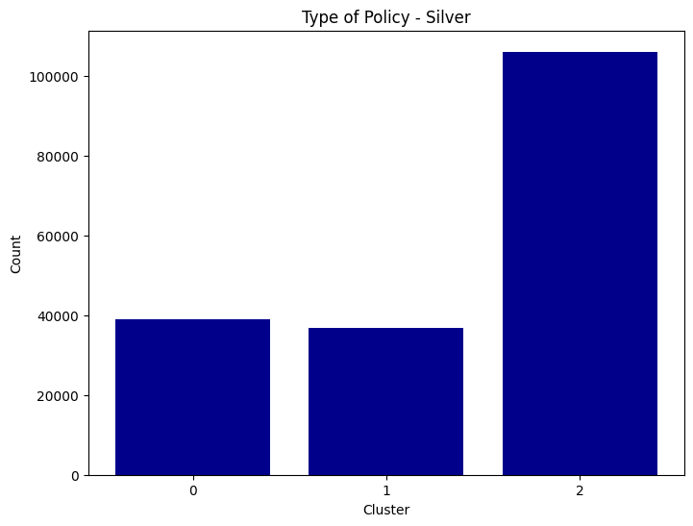
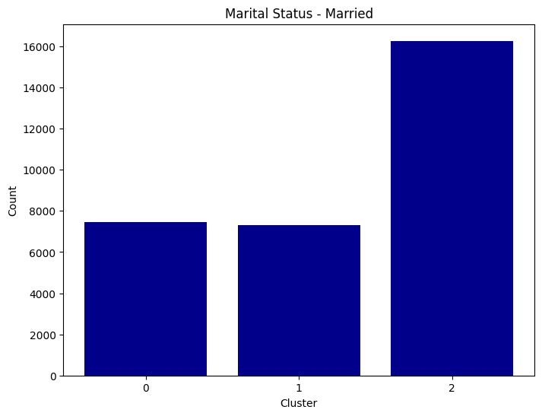
EDA

Slide 15
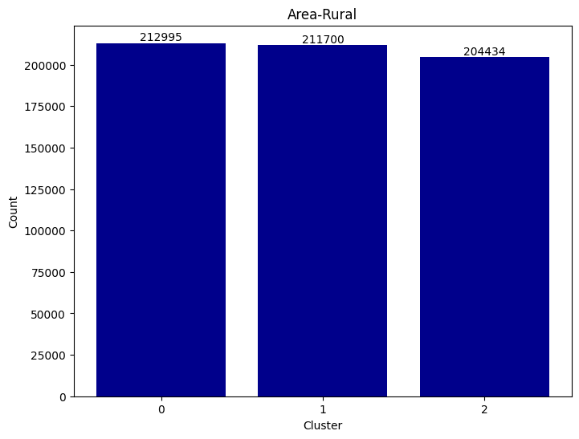
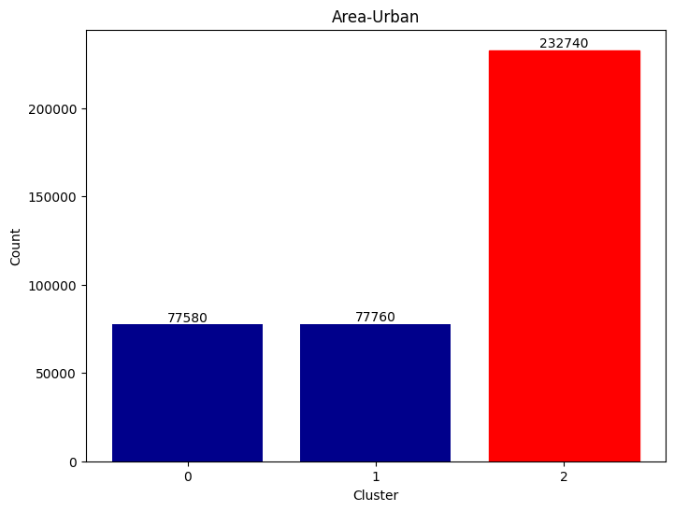
EDA

Slide 16
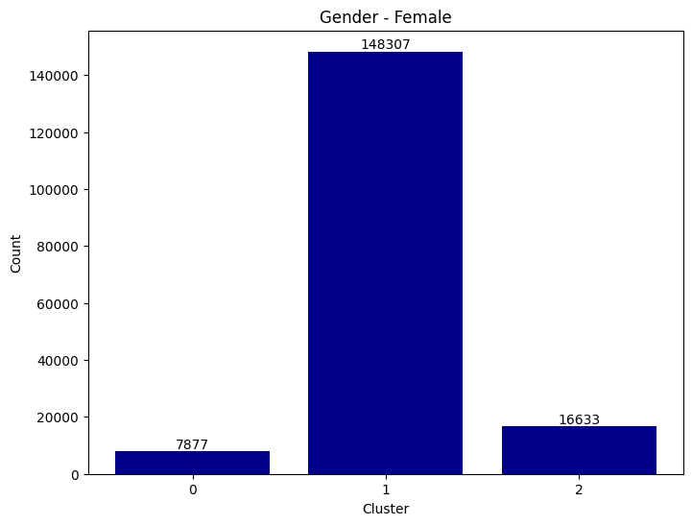
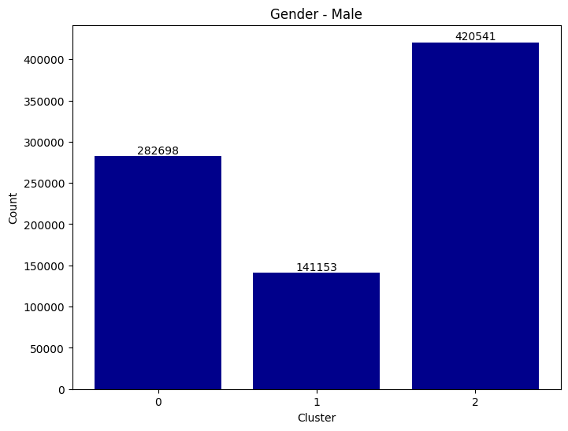
EDA - Gender

Slide 17
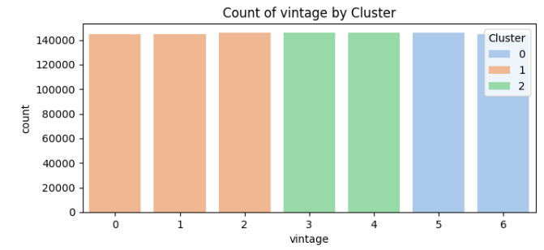
EDA- Vintage

Slide 18
Future Work
More Hyperparameter tuning to improve accuracy of Regression model for predicting CLTV
Clustering - Keep k-means clustering as base model and compare it with output from BIRCH clustering model to find AMI , ARI values to understand effectiveness of CLustering Models

Slide 19
THANK YOU

